Slide 1
Tableau Module 12
Data Analytics

Slide 2


























Common Charts
Data Views
Hierarchies
Data Structures
Basic Navigation
Dashboards
Data Stories
Calculations
Advanced
Charts
Certification Springs
Blending
Done
You are here

Slide 3
Learning Outcomes
Understand Value of Animation
Demonstrate creating waterfall charts
Demonstrate creating Pareto charts
Describe why Word Clouds are silly

Slide 4
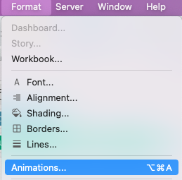
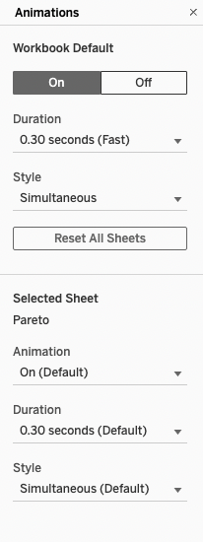
Animation

Slide 5
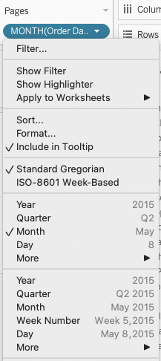
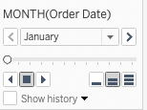
The Pages Card

Slide 6
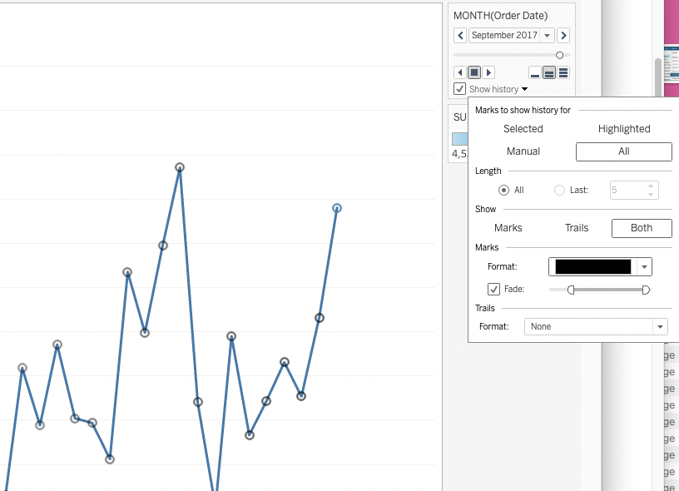
Displaying Trails

Slide 7
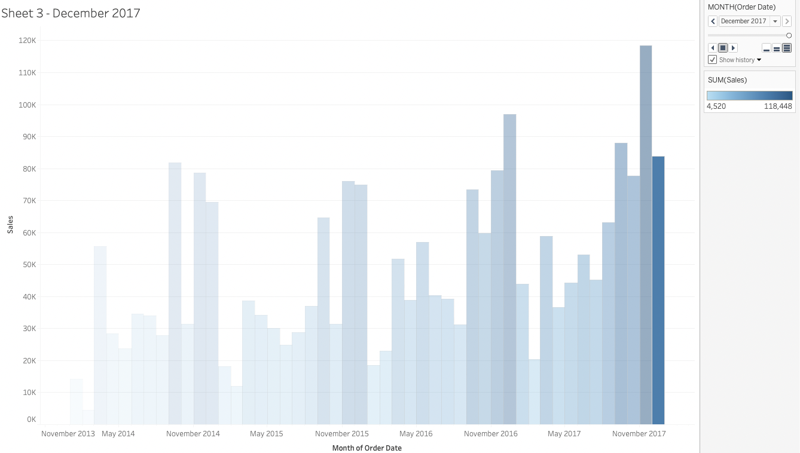
Playing Pages

Slide 8
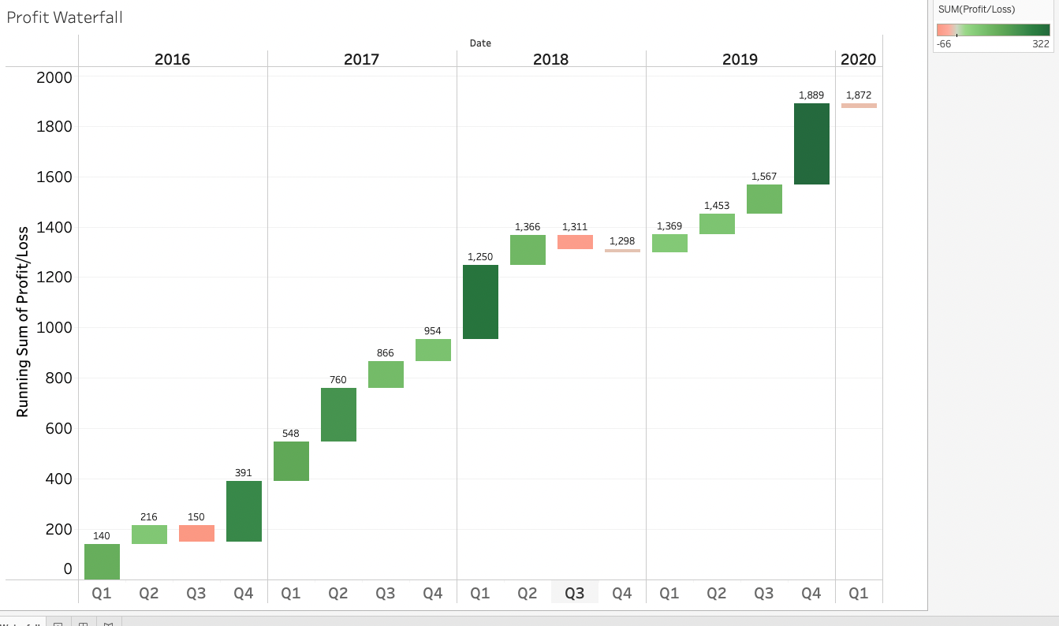
Waterfall Charts

Slide 9
Creating Waterfall Charts
Create a bar chart of a measure by some dimension (discrete time, categories)
Convert the bar chart to a Gantt bar
Add a “Quick Table Calculation” to change to “Running Total”
Create a new calculation called Waterfall and make it -1*your_measure’
Drag your Waterfall calculation into the mark size
Drag your measure into the mark color

Slide 10
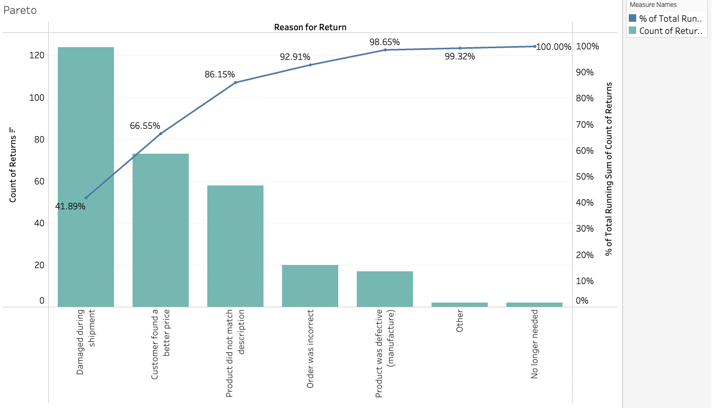
Pareto Charts
The line is cumulative percent of total

Slide 11
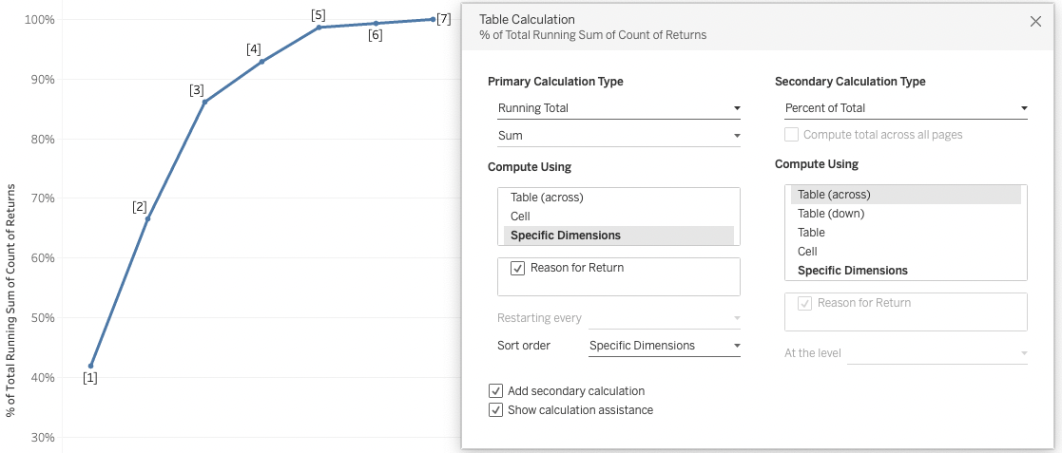
Creating Pareto Charts
Create a bar chart of ‘problems’ showing the discrete categories in decreasing order
Create a duplicate bar chart
Change one of the bar charts to a line chart
Change the line by adding a table calc to show ‘Running total’
Edit the calculation and add as ‘secondary calculation’ of ‘Percent of Total’
Merge the axes to make 1 chart

Slide 12
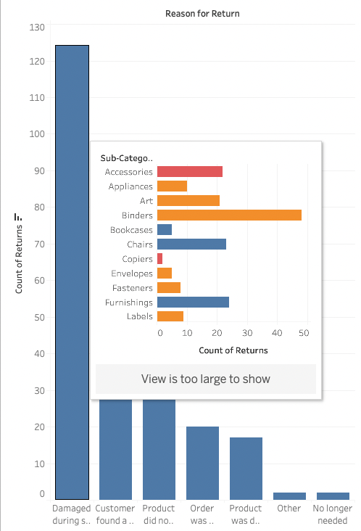
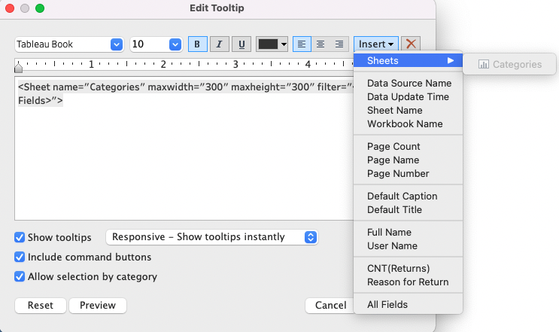
Viz in a Tooltip

Slide 13
Module 12 Challenge
us Superstore QA dataset
Create a Pareto chart using the “reason for return” in the x-axis and a count of returns in the y-axis
Add a tooltip Viz with additional information on the returns
2…

Slide 14
Lunch

